Slide 1


Slide 2

UPDATES
MANIPULATES
USES
SEES

Slide 3
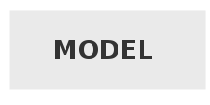
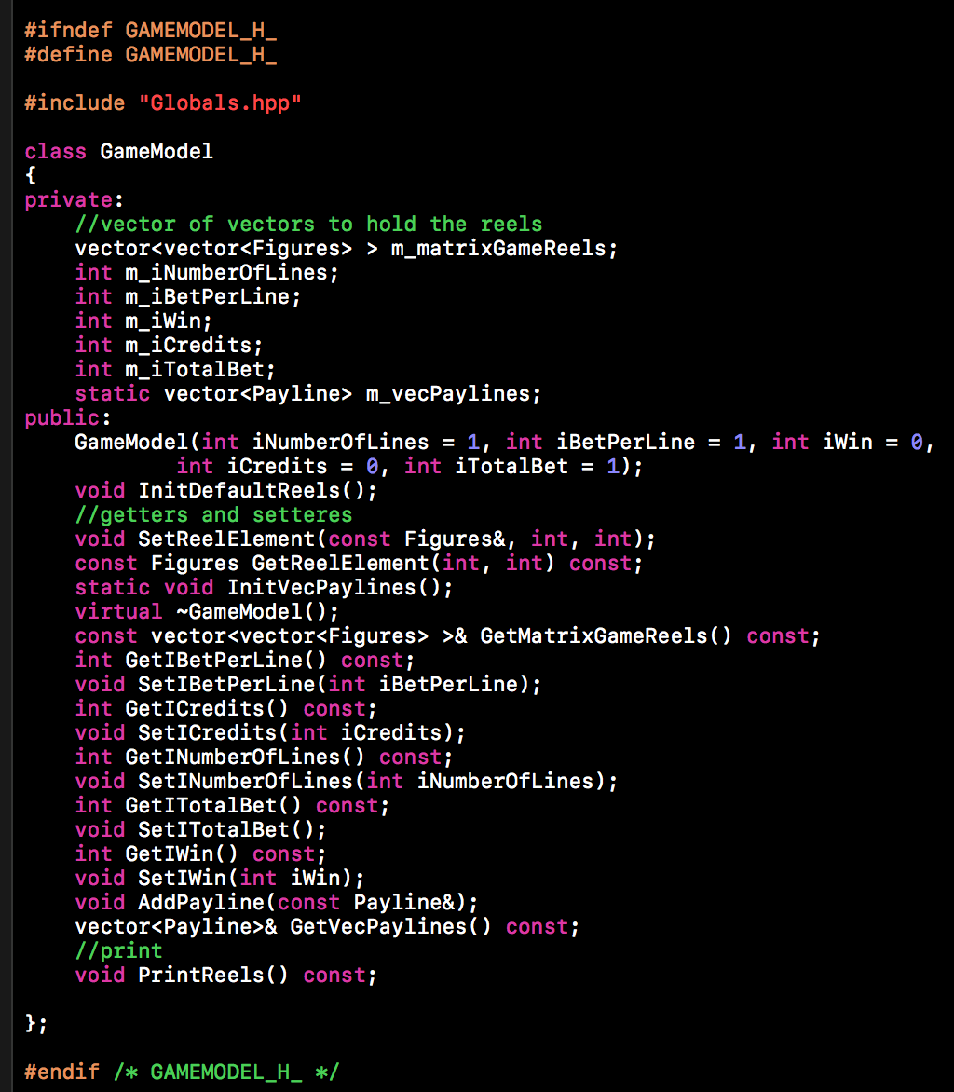
Ядро на
програмата

Slide 4

Връзката между модела на данните и изгледа.

Slide 5
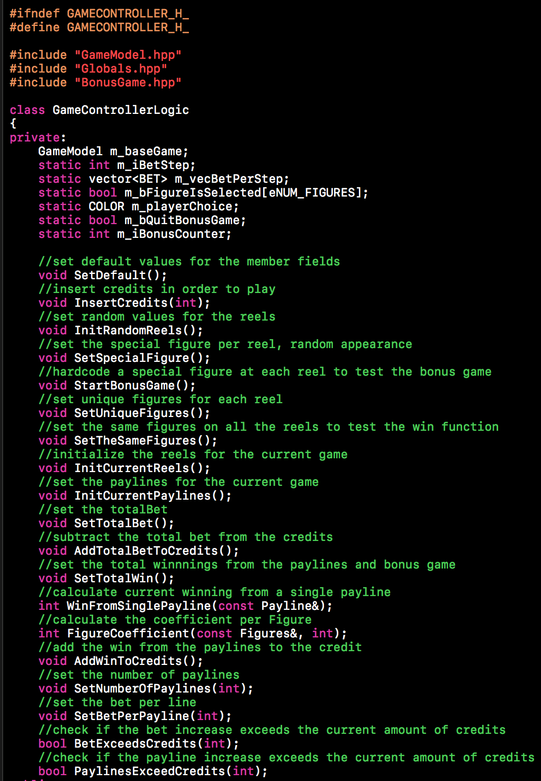

Slide 6
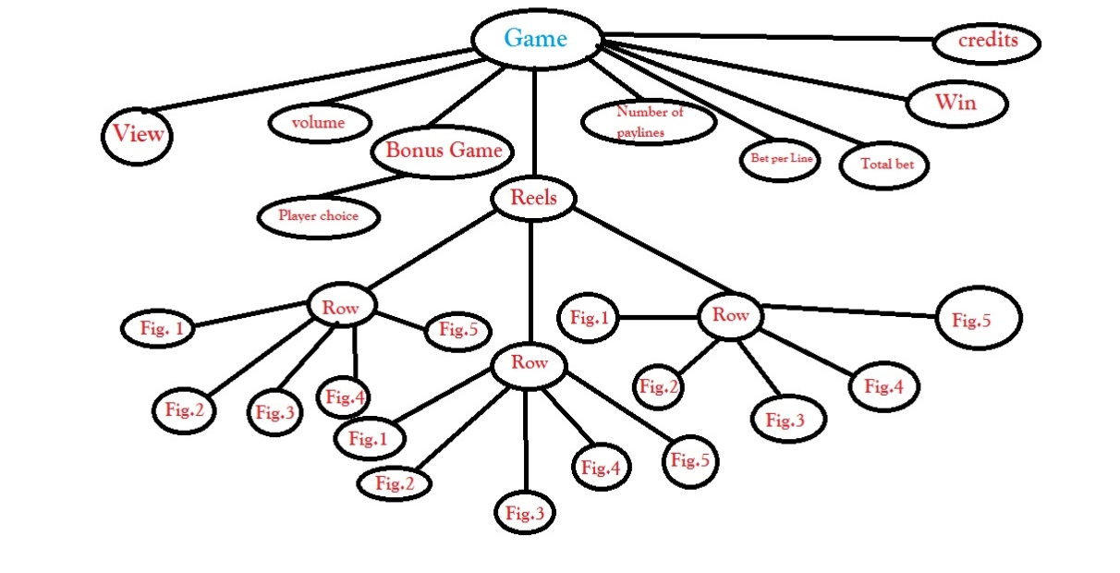
Съхранение на данни

Slide 7
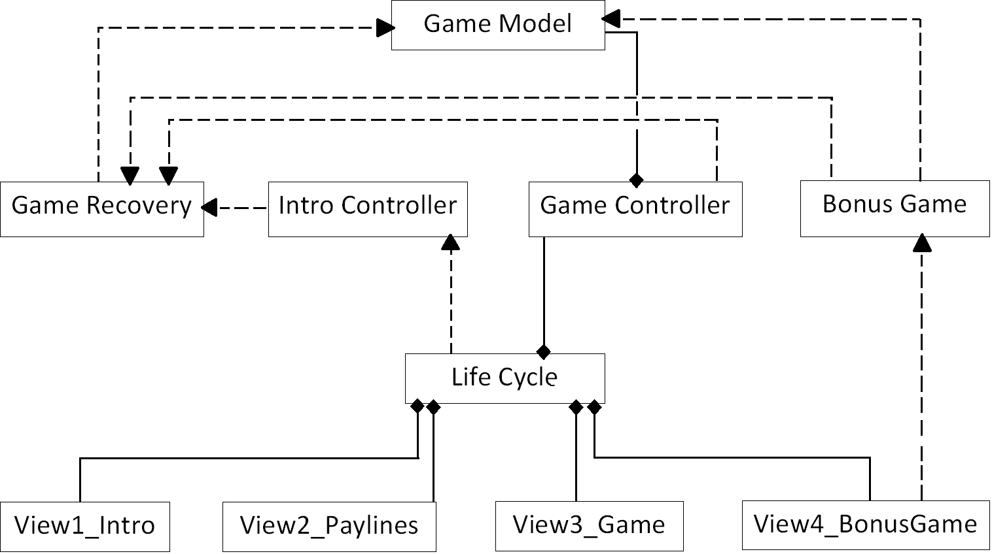
Релации между класовете

Slide 8

Основен изглед
на играта

Slide 9
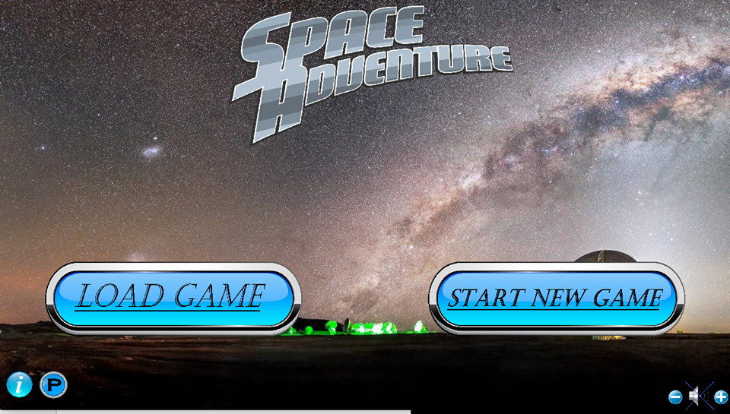
Първи изглед

Slide 10
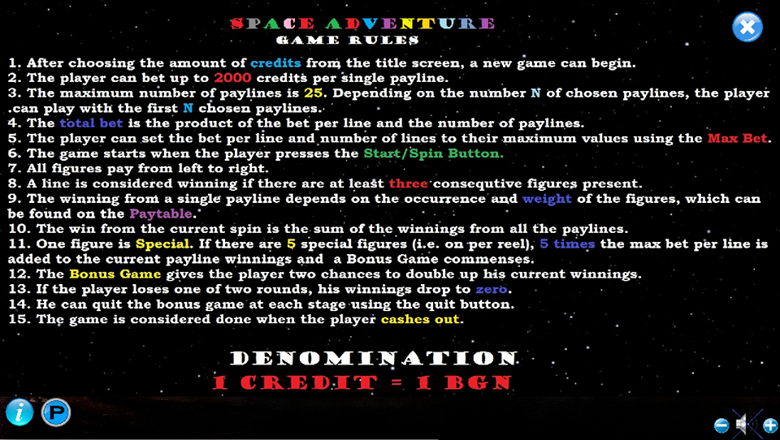

Slide 11
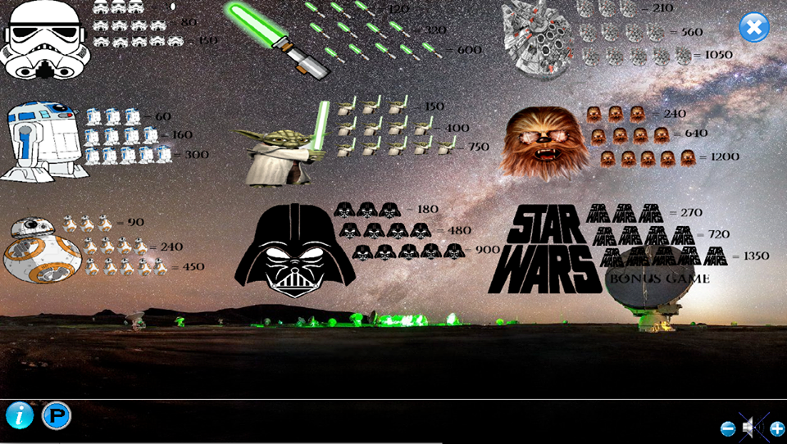

Slide 12
View 1:
Член полета:
-backgroundTexture : SDL_Texture
-logoTexture : SDL_Texture
-insertCreditTexture : SDL_Texture
-insertCreditPushedTexture : SDL_Texture
-infoTexture : SDL_Texture
- infoTexturePushed: SDL_Texture
-volumeTexture : SDL_Texture
-volumeTexture1 : SDL_Texture
-volumeTexture2 : SDL_Texture
-volumeTexture3 : SDL_Texture
-volumePlusButton : SDL_Texture
-volumePlusButtonPushed : SDL_Texture
-volumeMinusButton : SDL_Texture
-volumeMinusButtonPushed : SDL_Texture
-forwardButtonTexture : SDL_Texture
-pushedForwardButtonTexture : SDL_Texture
-spaceShipTexture : SDL_Texture
-spaceShipButtonPlus : SDL_Texture
-volumeMinusButtonPushed : SDL_Texture
-forwardButtonTexture : SDL_Texture
-pushedForwardButtonTexture : SDL_Texture
-spaceShipTexture : SDL_Texture
-spaceShipButtonPlus : SDL_Texture
-spaceShipButtonPlusPushed : SDL_Texture
-spaceShipButtonMinus : SDL_Texture
-spaceShipButtonMinusPushed : SDL_Texture
-spaceShipButtonOK : SDL_Texture
-spaceShipButtonOkPushed : SDL_Texture
-rulesTexture : SDL_Texture
-closeRulesButton : SDL_Texture

Slide 13
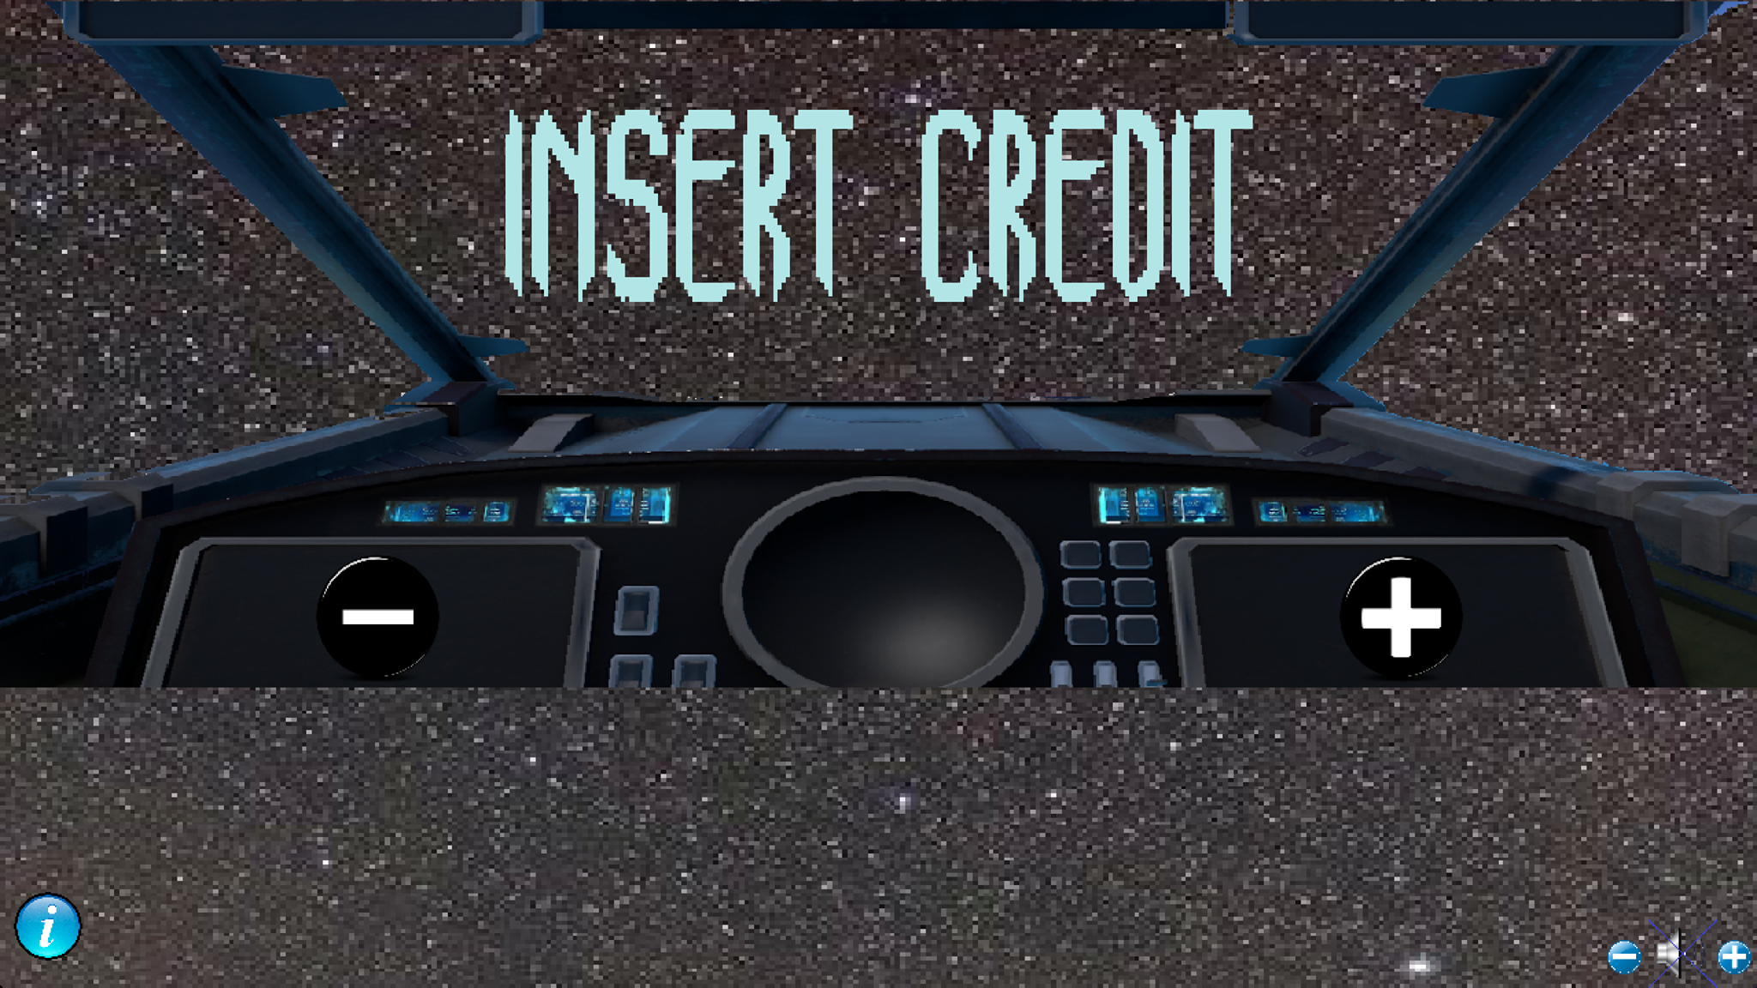
Кредит меню – към първи изглед

Slide 14
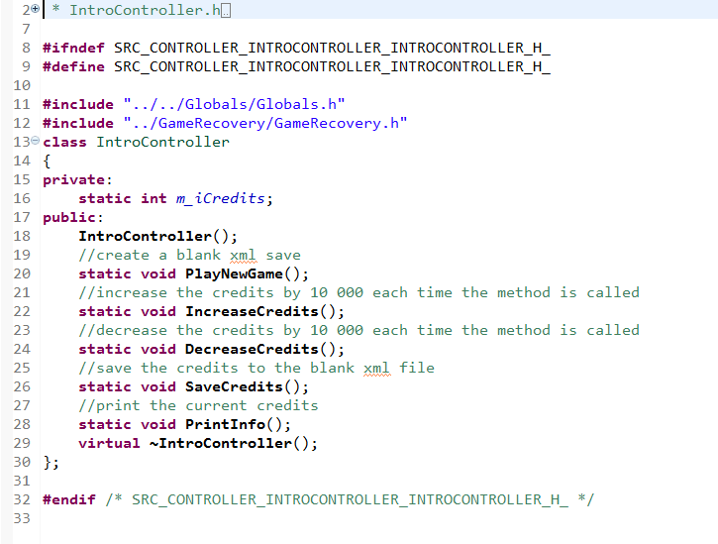

Slide 15
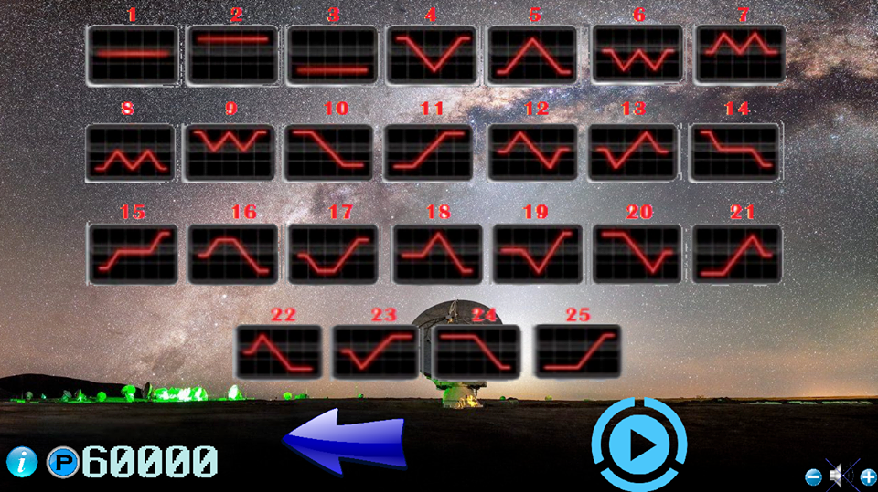
Втори изглед

Slide 16
View 2 – PayLines
Член – променливи:
-backButtonTexture : SDL_Texture
-backButtonTexturePushed : SDL_Texture
-playButtonTexture : SDL_Texture
-playButtonTexturePushed : SDL_Texture
-firstRow : SDL_Texture
-secondRow : SDL_Texture
-thirdRow : SDL_Texture
-fourthRow : SDL_Texture

Slide 17
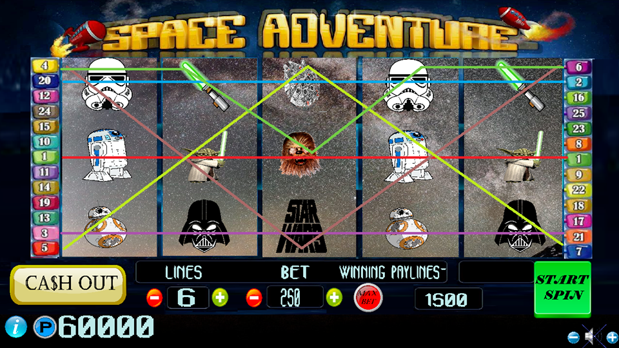
Трети (основен) изглед

Slide 18


Slide 19
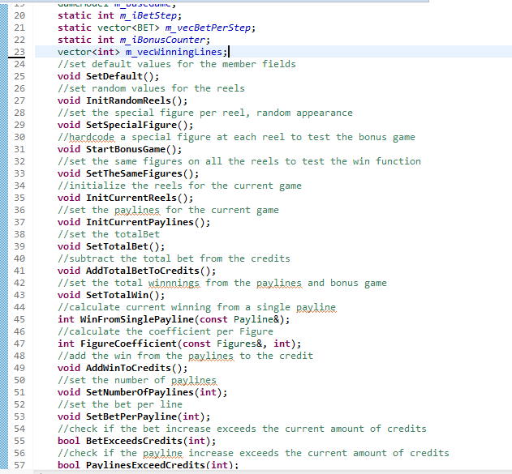

Slide 20
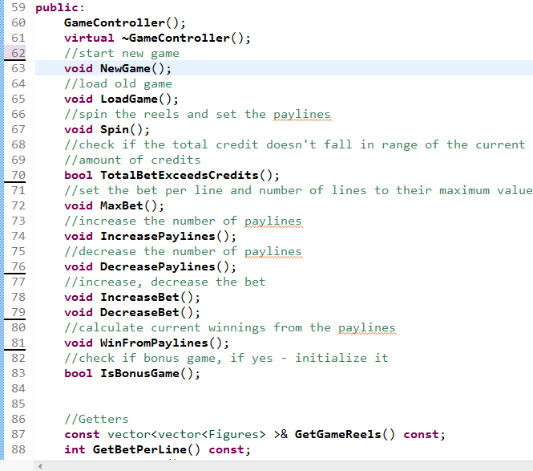

Slide 21
VIEW 3 – Slot
Член – променливи:
-slotTexture : SDL_Texture;
-startSpinButton : SDL_Texture;
-startSpinButtonPushed : SDL_Texture;
-maxBetButton : SDL_Texture;
-maxBetButtonPushed : SDL_Texture;
-plusLinesButton : SDL_Texture;
-plusLinesButtonPushed : SDL_Texture;
-minusButtonLines : SDL_Texture;
-minusButtonLinesPushed : SDL_Texture;
-minusButtonBet : SDL_Texture;
-minusButtonBetPushed : SDL_Texture;
-plusButtonBet : SDL_Texture;
-plusButtonBetPushed : SDL_Texture;
-cashOutButton : SDL_Texture;
-cashOutButtonPushed : SDL_Texture;
-whiteScreenTexture : SDL_Texture;
-eFigure1 : SDL_Texture – eFigure9 : SDL_Texture;
-line1 : SDL_Texture – line25 : SDL_Texture;

Slide 22
LifeCycle
Член – променливи:
+Rect : RectStruct;
LifeCycle() – constructor;
+ InitMedia : void;
+ Play() : void;
+ QuitGame() : void;
// Utility Methods ->
+ LoadTexture(path: string): SDL_Texture*;
+ operator = (newObject: SDL_Rect) : SDL_Rect*;
+ Object : SDL_Rect*;
+ createRect(x: int, y: int, w: int, h: int) : SDL_Rect;
+ PreparingTexturesView1():void;// Loading Textures View 1
+ PreparingTexturesView2():void; // Loading Textures View 2
+ PreparingTexturesView3():void; Loading Textures View 3
+ PreparingTexturesCashOutAnimation():void;
+ PreparingTextures():void; // Loading all Textures
+ CreateRectsInStruct():void; // Creating Rects in Struct

Slide 23
+ LoadMusic():void; // Loading Music
+ PresentView1():void; // Present View 1
+ CreditMenu(spaceShipHidden: bool): void;// Effect Credit Menu
+ PresentCreditMenu(presentSpaceShip: bool): void
+ CreditMenuZoomOut(okPushed: bool): void // Effect Credit Menu Zoom Out
+ PassingToView2():void; // Passing to View 2 Animation
+ PresentView2():void // Present View 2
+ LinesEffectComing():void; // Effect Lines View 2 Coming
+ BackToView1():void // Effects Lines View 2 Gone and Back to View 1
+ PassingToView3():void // Effects Lines 1,2,3,4 View 2 GONE and Slot View 3 Coming
+ PresentView3():void; // Presenting View 3
+ WinningLines():void
+ SpinningReels():void; // Spinning REELS
+ CashOutAnimation():void; // Cash Out Animation
+ WhiteScreenAndCashOutAnimation():void; // FULL ANIMATION Cash Out

Slide 24
БОНУС ИГРА

Slide 25
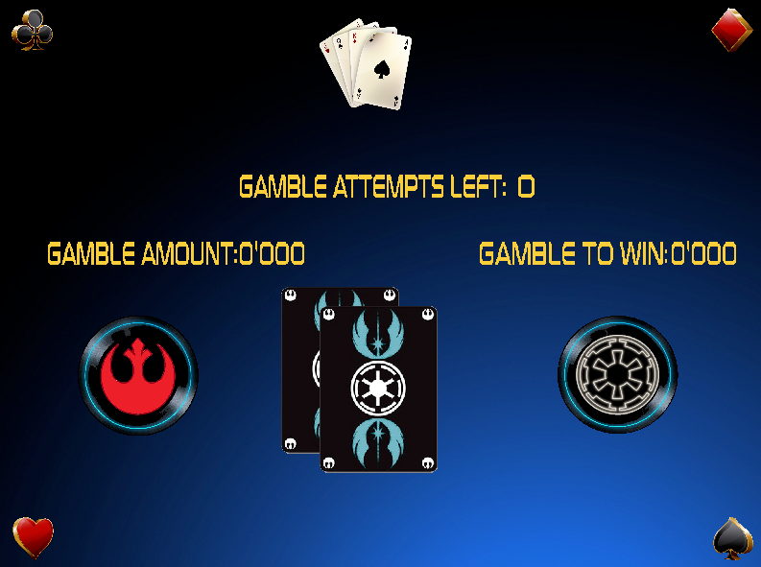

Slide 26


Slide 27
Член-функции
+ BonusGame();
+ IsBonusGame(int): bool
+ InitBonusGame(gameModel: GameModel*): void
- SetBonusGameResult(): void
- UpdateIfWin(): void
- UpdateIfLoss(): void
+ PlayerSelectedBlack(): void
+ PlayerSelectedRed(): void
- IsValidBet(): bool
- PlayerWon(): bool
- DoubleUpWins(): void
+ PlayBonusRound(): void
+ WinBonusRound(): void
+ GambleAmount(): string
- UpdateWinAndCredits(): void
- SetDefault(): void
+ GambleToWin(): string
+ IsQuitBonusGame(): bool
+ QuitBonusGame(): void
+ virtual ~BonusGame()
BonusGame
Полета
- m_baseGamePtr: GameModel*
- m_iRandCounter: int
- m_playerChoice: COLOR
- m_bonusGameResult: COLOR
- m_iCredits: int
- m_iBet: int
- m_iGameWin: int
- m_iBonusWin: int
- m_bWonRound1: bool
- m_iRound: int
- m_bQuitBonusGame: bool

Slide 28
Изготвили:
Симеон Ангелов
Илия Илиев
Димитринка Вълкова
Михаел Мушков

Slide 29
